Slide 1
MTP-5 data analyze
Anna Gnevasheva
Elena Khavina
Svetlana Lisova
Maria Parfenova
Ekaterina Perminova
NABOS-2013

Slide 2
What is MTP-5?
Meteorological Temperature Profiler (MTP-5)

Slide 3
Technical specifications
We use MTP-5H model.
Heights Range | 0-600 m
Displayed height interval | 50 m
Accuracy (C) 0 - 50 meters | 0,5
Accuracy (C) 50 - 600 meters | 0,5 ÷ 1,0
Weight | 25 kg
Temperature range | -40°C ÷ +50°C

Slide 4
How it works

Slide 5
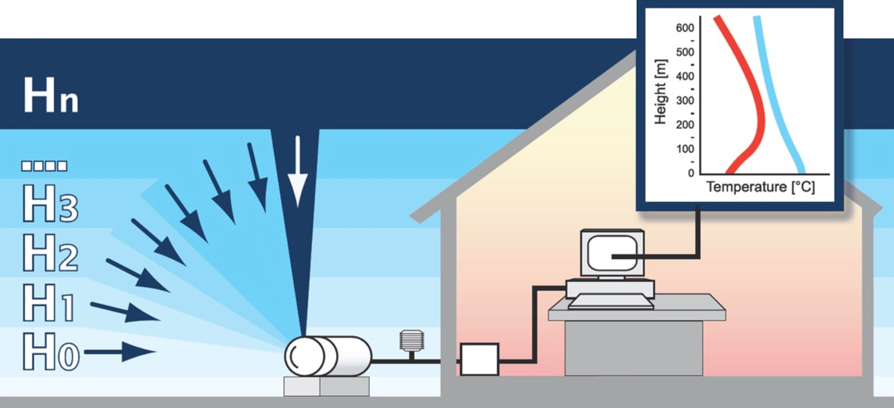
How it works
Every 5 minutes the program starts measuring the temperature profile. It sends commands to controller and scanner goes through series of angles from 0° ÷ 90°, i = 1 ÷ n, n = 11.

Slide 6
How it works
The program is measuring the signal from the radiometer (receiver) in Volts (Ui[V]) when scanner is stopped at each angle. The array of Ui(q) is calculated to the array of brightness temperature Tb(q) with equation: Tb(θ) = Ui[V]* A[K/V] +B[K], where A and B are calibrations coefficients.

Slide 7
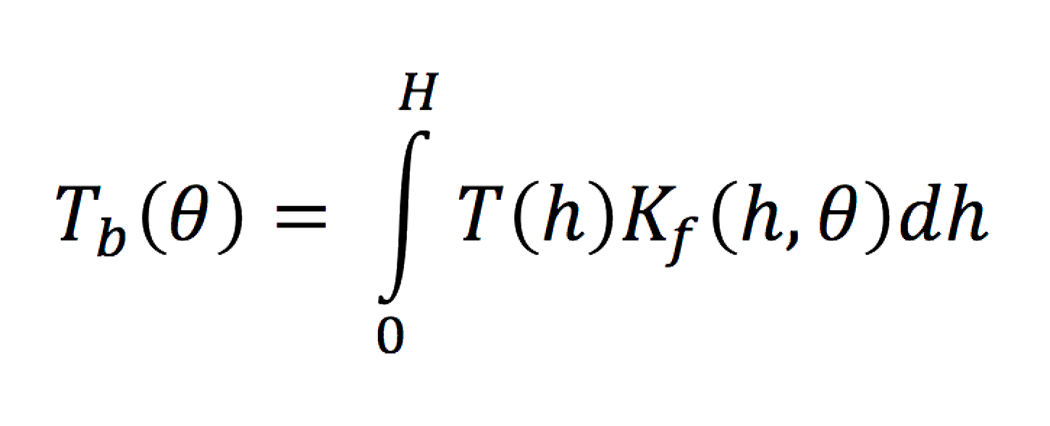
How it works
After the program gets the Tb (θ), it becomes possible to calculate the temperature T(h)[K].
The equation of T(b) is:
in discrete form is where δ is an unknown error component, that will effect the solution to some degree. And K is a kernel.

Slide 8
How it works
“As the working frequencies chosen in the center of molecular oxygen absorption band, where the attenuation is very high, fog, changes in water vapor density, clouds and weak rain do not influence the measurements. So we have a good T(b).”
MTP-5 official presentation

Slide 9
Is MTP-5 good in cloud weather?
Nowadays we have not enough MTP-5 data to check if it works correctly in high humidity and cloudiness conditions.
To check the quality of MTP-5 data we compared it to Kensuke’s Sond data.

Slide 10
What is radioSONDe?
temperature sensor
relative humidity sensor
pressure sensor
wind speed & direction sensor
Radiosondes are used to measure the meteorological parameters profiles.

Slide 11
MTP-5 vs SOND temperature profiles
08.09.13 12:00

Slide 12
MTP-5 vs SOND temperature profiles
30.08.13 17:30

Slide 13
Correlation between the MTP-5 and sond at 22 m height

Slide 14
Correlation between the MTP-5 and sond at 72 m height

Slide 15
Correlation between the MTP-5 and sond at 122 m height

Slide 16
Correlation between the MTP-5 and sond at 172 m height

Slide 17
Correlation between the MTP-5 and sond at 222 m height

Slide 18
Correlation between the MTP-5 and sond at 272 m height

Slide 19
Correlation between the MTP-5 and sond at 322 m height

Slide 20
Correlation between the MTP-5 and sond at 372 m height

Slide 21
Correlation between the MTP-5 and sond at 422 m height

Slide 22
Correlation between the MTP-5 and sond at 472 m height

Slide 23
Correlation between the MTP-5 and sond at 522 m height

Slide 24
Correlation between the MTP-5 and sond at 572 m height

Slide 25
Correlation between the MTP-5 and sond at 622 m height

Slide 26
Correlation coefficients
Height (m) | Correlation coefficient R²
22 | 0,84
72 | 0,88
122 | 0,81
172 | 0,84
222 | 0,84
272 | 0,83
322 | 0,75
372 | 0,67
422 | 0,62
472 | 0,69
522 | 0,84
572 | 0,91
622 | 0,88

Slide 27
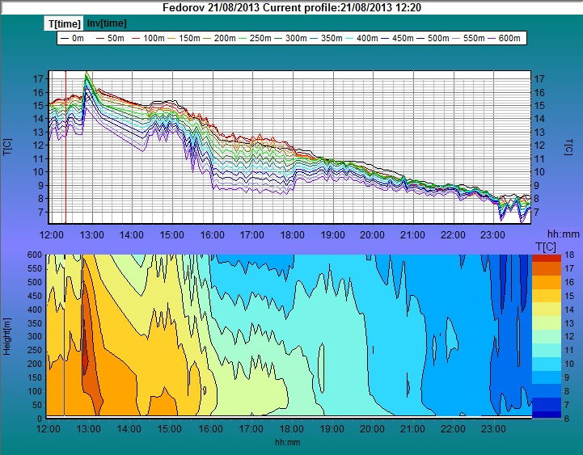
Cold front

Slide 28
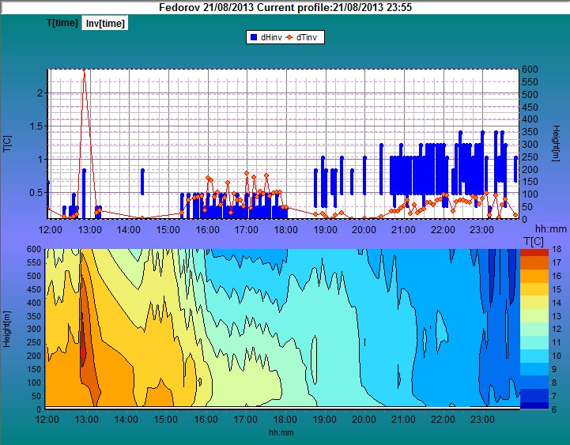
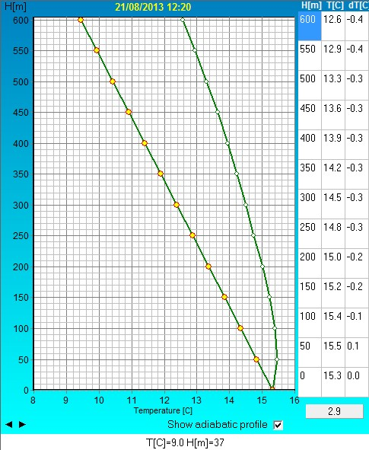
21.08.2013 (Cold front)
Time | Inversion type | Low Border (m) | High border (m) | Average t (ͦ C) | tmax (ͦ C)
12:15-13:15 | radiational | 0 | 200 | 0.25 | 2.5
15:15-18:00 | radiational | 0 | 100 | 0.5 | 0.75
18:45-24:00 | advective | 50 | 350 | 0.4 | 0.5
Type or stratification– stable
Mixing layer height =60 m
Front – cold

Slide 29
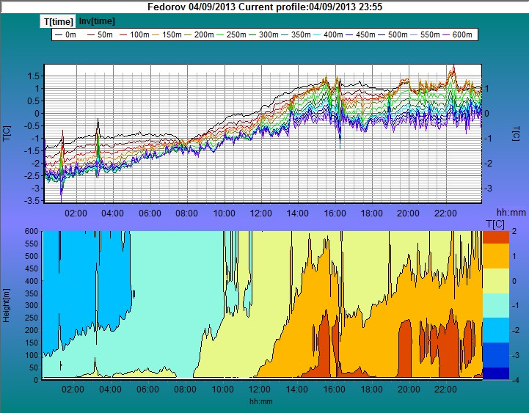
Ice edge crossing (sea ice to open water)

Slide 30
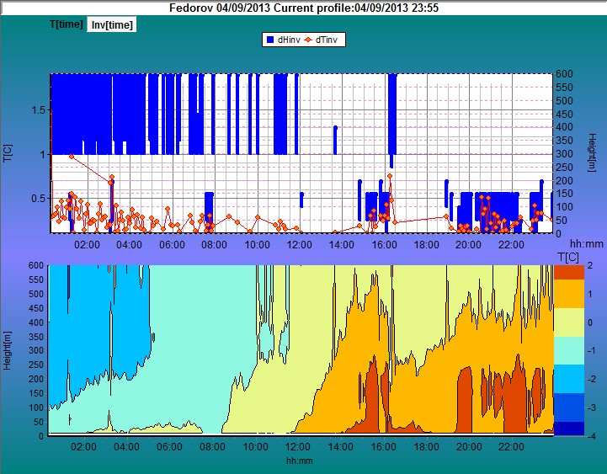
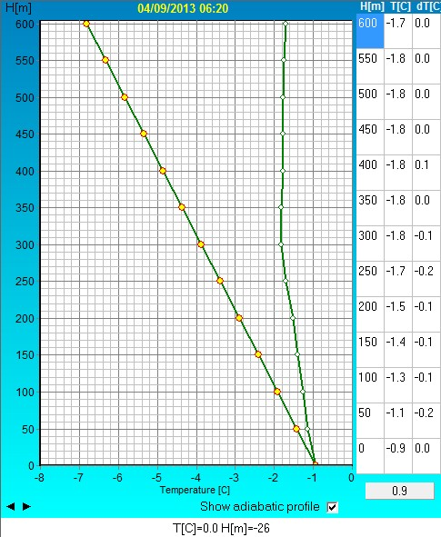
04.09.2013 (Warm front)
Time | Invertion type | Low border (m) | High Border (m) | Average t (ͦ C) | tmax (ͦ C)
00:00-12:00 | advective | 100 | 600 | 0.3 | 1
14:50-16:35 | advective | 50 | 600 | 0.4 | 0.7
19:25-24:00 | neutral(>rad) | 200 | 0/50 | 0.3 | 0.5
Type of stratification – neutral
Mixing layer height =110 m
Front – warm outbreak

Slide 31
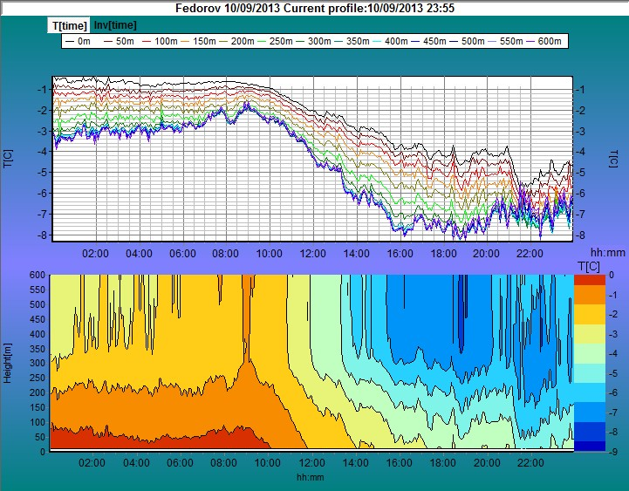
Ice edge crossing (open water to sea ice)

Slide 32
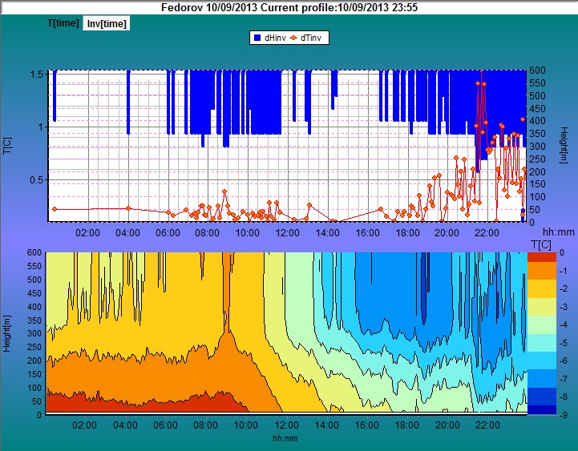
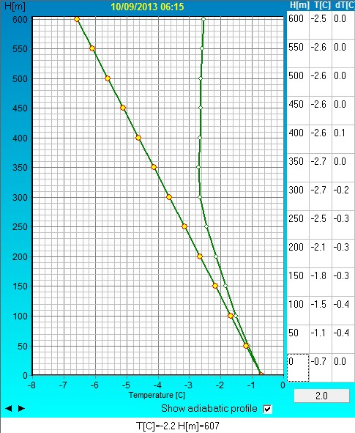
10.09.2013 (Cross ice edge )
Time | Invertson type | Low border (m) | High border (m) | Average t (ͦ C) | tmax (ͦ C)
06:00-11:40 | advective | 300 | 600 | 0.18 | 0.4
16:30-24:00 | advective | 200 | 600 | 0.6 | 1.6
Type of stratification – unstable
Boundary layer Height =80 m
Front – ice edge crossing (from open water to sea ice)

Slide 33
Total and low cloud fraction variation during NABOS-2013 expedition

Slide 34
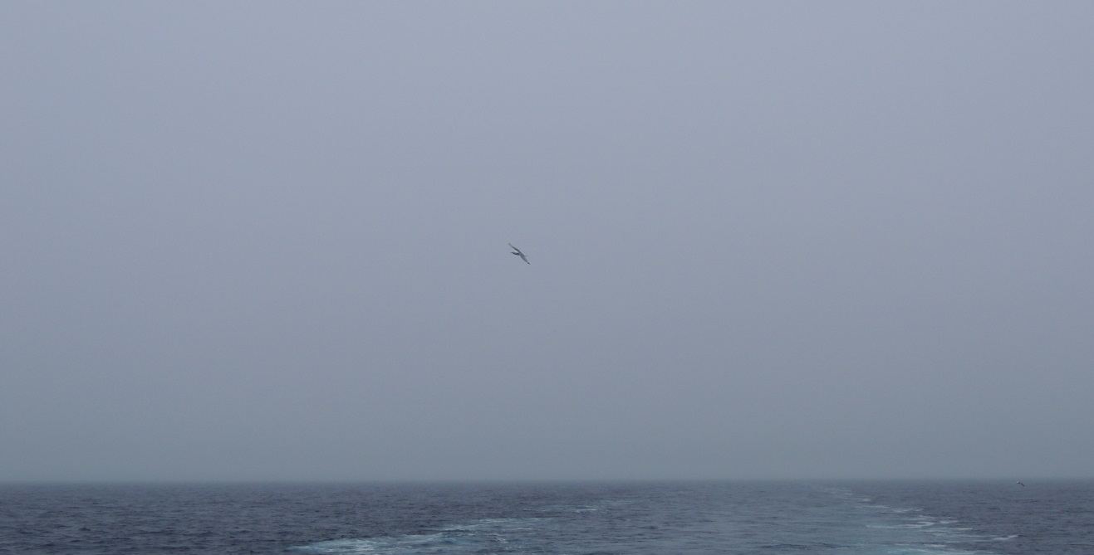
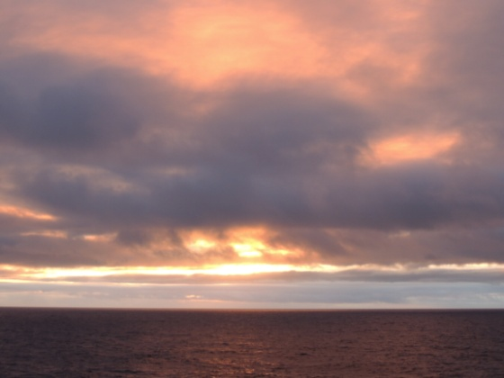
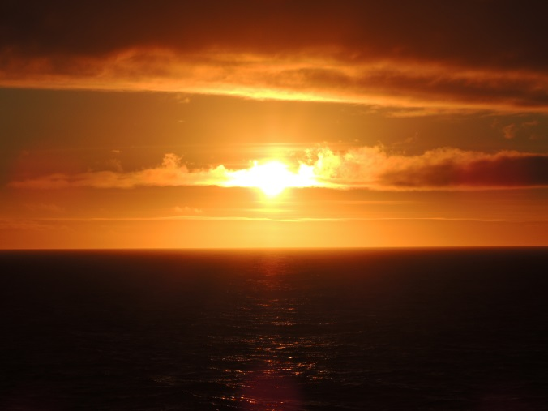
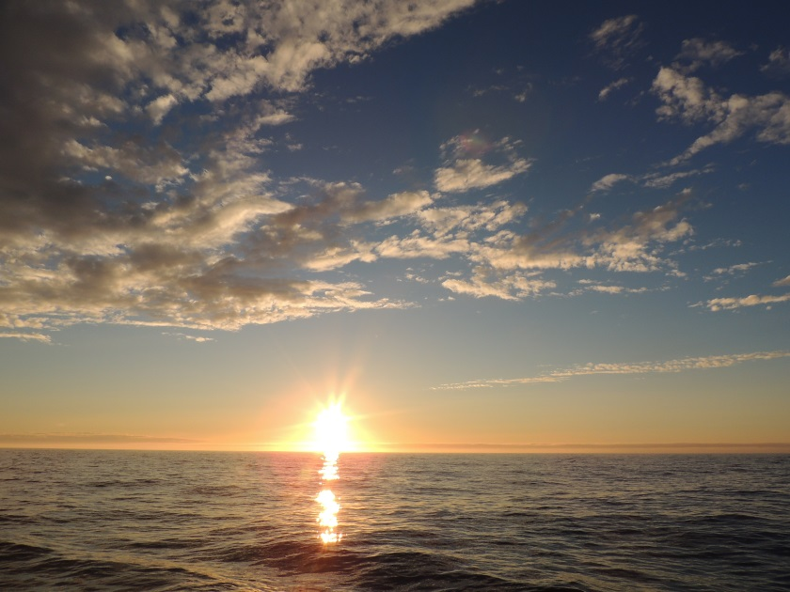
Clouds
Stratus nebulosus
Altostratus undulatus
translucidus
Stratocumulus vesperalis
Altocumulus inhomogenus
Cirrus intortus
Cirrocumulus cumuliformis

Slide 35
Distribution of total and low cloud fraction (Fig.1) and cloud types (Fig.2)

Slide 36
Distribution of low and total cloud fraction and cloud types in the dependence on ICE/WATER as the underlying surface.
ICE
WATER

Slide 37
Conclusions
MTP-5 accuracy is not good for the stratus cloudy areas now (e.g. Arctic Ocean) as the algorithm of raw data processing doesn’t consider humidity conditions.
In spite of this MTP-5 data is quite good for inversion detection and general atmospheric monitoring.
During our expedition the southeast wind was prevailing for a long time that caused the advection of warm air. Due to cold underlying surface we also had strong inversions that determined the presence of very low clouds covering the whole sky.

Slide 38
Thank you!
We hope it was interesting for you.^^

